Slide 1
When Onesimus Risked it all
Philemon er

Slide 2
Everyday we take Risk- which have you done?
Bungee jumping Hang gliding Performing in front of a crowd Cliff jumping Asking someone out on a date Driving a car Skydiving Public speaking Gambling Rock climbing Investing some money

Slide 3
Which ones do you think are not worth the risk? If these things are risky, why do people do them?
We all take risks in our lives and leaders must take even more. Some may be so minor that we barely think about it, and some are so big that we don’t take them at all. The story of this unlikely hero involved many risks.

Slide 4
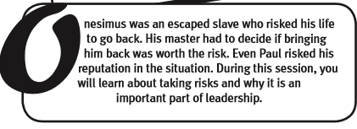
ONesimus

Slide 5
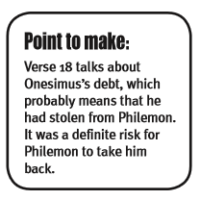
In the book of Philemon, Paul writes about Onesimus, a former slave who took a risk to escape slavery, but now takes a bigger risk to ask for forgiveness. Read Philemon vv.10-14 to get insight on the risks that Philemon, Onesimus, and Paul would take.

Slide 8
The Providence of God
(vv.15-16) Paul suggests that in God’s providence Onesimus abandoned Philemon during this short time for the purpose of Onesimus coming to faith in Christ Jesus. Theologians often describe this as God’s invisible hand moving about in the lives of those who are His often in order to bring good out of evil (Genesis 50:20; Romans 8: 28). As a result, the fellowship between Philemon and Onesimus would be rich, considering they were now brothers and free in Christ, slaves only to righteousness.

Slide 12
Are you willing to take the risk?

