Slide 1
Jesus is forgiving
Luke 22:31-34, 54-62; John 21:1-19

Slide 2
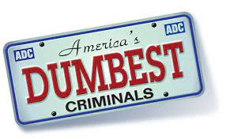

Slide 3
Police in Ossining, New York were called to a mini-mart, where they found Blake Leak, 23, trying to break in. They chased Leak through the streets until…..
A. Leak ran to the lobby of the Ossining Police Building.
B. Leak ran to the lobby of the Sing Maximum Security Prison
C. Leak ran and hid on a construction site where he fell into fresh concrete.
D. He tried to steal a police car with the K-9 Unit (dog) in the back seat.

Slide 4
Police in Ossining, New York were called to a mini-mart, where they found Blake Leak, 23, trying to break in. They chased Leak through the streets until…..
B. Leak ran to the lobby of the Sing Maximum Security Prison where he was quickly caught and booked.

Slide 5
Scottish shoplifter Aron Morrison was picked up after stealing a bottle of vodka from a liquor store. It didn’t take Sherlock Holmes to find Morrison because……
A. He left his name and number with the Clerk he had asked on a date.
B. He had made a phone call to his mom asking for a car ride home, leaving the name with the clerk.
C. He left his wallet in the display case where he had stolen the vodka.
D. He had asked to use the restroom and left his wallet on the side of the toilet.

Slide 6
Scottish shoplifter Aron Morrison was picked up after stealing a bottle of vodka from a liquor store. It didn’t take Sherlock Holmes to find Morrison because……
A. He left his name and number with the clerk which he had asked her on a date. They caught him in no time.

Slide 7
A trio of drug thieves broke into a home in Silver Springs, Florida, and discovered three jars of cocaine. They took it home and snorted the contents. That’s when they discovered that the jars were in fact
A. Powdered sugar that contain trace amounts of poison.
B. The cremated remains of the husband and the family’s 2 cremated dog.
C. The grandmother’s Antique gun powder that was toxic.
D. The remains of the family’s pet snake, Slithers.

Slide 8
A trio of drug thieves broke into a home in Silver Springs, Florida, and discovered three jars of cocaine. They took it home and snorted the contents. That’s when they discovered that the jars were in fact
B. The cremated remains of the husband and the family’s 2 cremated dog.

Slide 9
In Beavercreek, Ohio, a thief stepped into the bank and started robbing it until the unfortunate happened…
A. He had to go to the bathroom and the police had time to catch him.
He received a phone call that his wife was in labor and had to abandon the job.
C. He realized that his brother worked at the bank and his cover was blown.
D. He fainted in the middle of the job- and the pólice and paramedics were both called.

Slide 10
In Beavercreek, Ohio, a thief stepped into the bank and started robbing it until the unfortunate happened…
D. He fainted in the middle of the job- and the pólice and paramedics were both called.

Slide 11
A Good Samaritan noticed an elderly man being robbed, so he jumped in and punched the thief. The thief was so upset…
A. He ran away without looking and ran straight into a pole, knocking himself unconscious.
B. He called 911 to complain to the police.
C. He called his wife to complain who happened to be already in police custody.
D. He fainted of anger and woke up to notice that his wallet had generously been emptied.

Slide 12
A Good Samaritan noticed an elderly man being robbed, so he jumped in and punched the thief. The thief was so upset…
B. He called 911 to complain to the police.

Slide 13
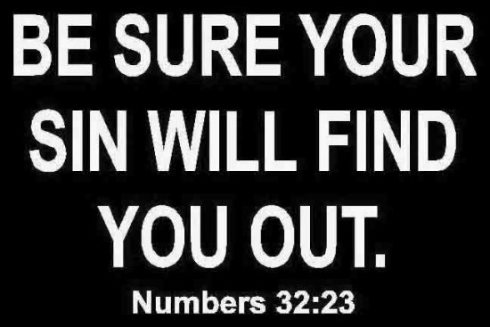
The Bible says-

Slide 14
things people do when they sin-

Slide 15
1. Deny it.
²⁰ “But I did obey the Lord!” Saul answered.^{[d]} “I went on the mission the Lord gave me: I brought back Agag, king of Amalek, and I completely destroyed the Amalekites. ²¹ The troops took sheep and cattle from the plunder—the best of what was set apart for destruction—to sacrifice to the Lord your God at Gilgal.” 1 Samuel 15:20-21

Slide 16
2. Blame others.
¹² Then the man replied, “The woman You gave to be with me—she gave me some fruit from the tree, and I ate.” Genesis 3:12

Slide 17
3. Minimize your sin.
³ Why do you look at the speck in your brother’s eye but don’t notice the log in your own eye? Matthew 7:3

Slide 18
4. Justify it. Samuel didn’t come, so Saul did what he was not allowed to do. Saul, however, was still at Gilgal, and all his troops were gripped with fear. ⁸ He waited seven days for the appointed time that Samuel had set, but Samuel didn’t come to Gilgal, and the troops were deserting him. ⁹ So Saul said, “Bring me the burnt offering and the fellowship offerings.” Then he offered the burnt offering. 1 Samuel 13:7-9.

Slide 19
5. Admit it.
⁹ If we confess our sins, He is faithful and righteous to forgive us our sins and to cleanse us from all unrighteousness.
1 John 1:9

Slide 22
By continuing to resist and reject the Lord, you build calluses on your soul until the conviction of the Spirit of God no longer registers in your heart. Over time, you become hardened. You hear the Word of God, and it makes no impact on you. If you die in that condition, there’s no further forgiveness available. David Jeremiah

Slide 23
Today’s Point: Jesus is forgiving even when I sin. Peter denied Jesus three times, but Jesus appeared to him after His resurrection and restored Peter. Jesus came to die on the cross and rise from the grave to bring forgiveness of sins and restoration to God.

Slide 24
1. Jesus warns that Satan wants to destroy us. Luke 22:31-
31 “Simon, Simon, look out! Satan has asked to sift you like wheat.

Slide 25
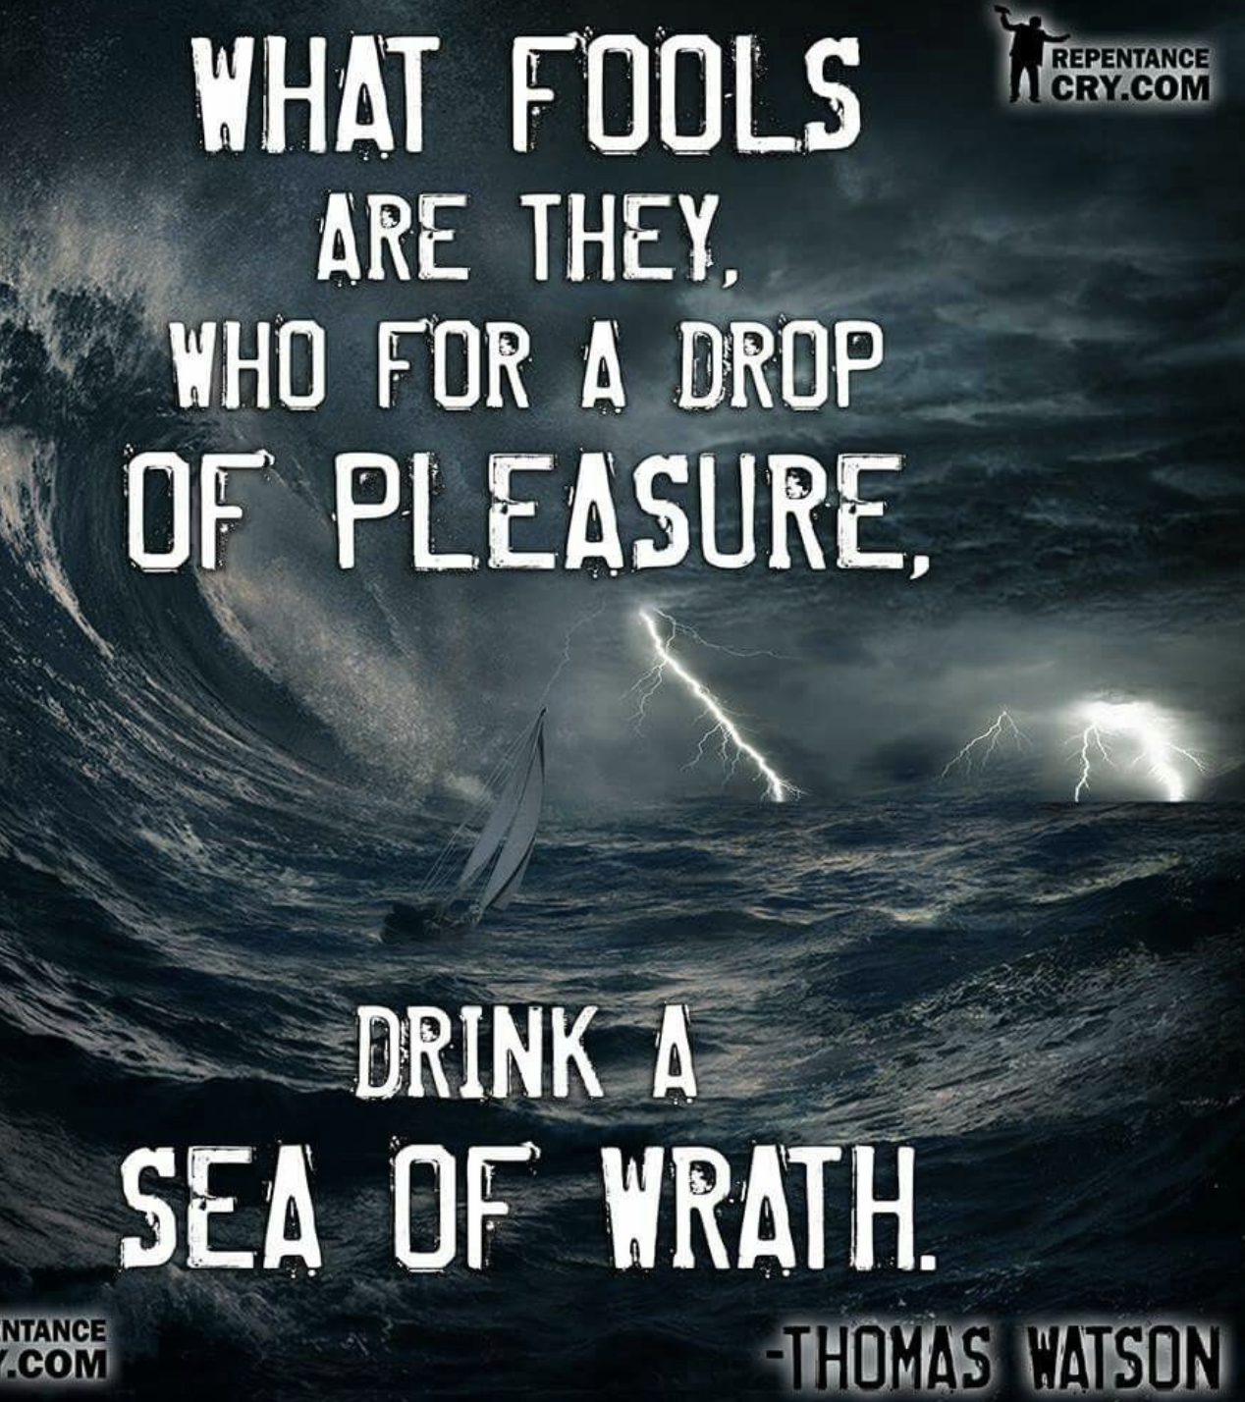

Slide 26
2. Jesus intercedes on our behalf and reminds us that dependence on God and His word are the only way to combat Satan. Luke 22:32-34.
32 But I have prayed for you that your faith may not fail. And you, when you have turned back, strengthen your brothers.”
33 “Lord,” he told Him, “I’m ready to go with You both to prison and to death!” 34 “I tell you, Peter,” He said, “the rooster will not crow today until you deny three times that you know Me!”

Slide 27
3. Pride will ultimately lead us to blatantly reject Jesus as the Son of God. (Luke 22:54-62)
⁵⁹ About an hour later, another kept insisting, “This man was certainly with Him, since he’s also a Galilean.”
⁶⁰ But Peter said, “Man, I don’t know what you’re talking about!” Immediately, while he was still speaking, a rooster crowed. ⁶¹ Then the Lord turned and looked at Peter. So Peter remembered the word of the Lord, how He had said to him, “Before the rooster crows today, you will deny Me three times.” ⁶² And he went outside and wept bitterly.

Slide 28
After Jesus’ death and resurrection- Jesus finds the disciples fishing- Peter had returned to what he had done before he met Jesus. ³ “I’m going fishing,” Simon Peter said to them. “We’re coming with you,” they told him. They went out and got into the boat, but that night they caught nothing

Slide 29
Jesus shows up and the disciples don’t recognize him at first- he tells them to cast their nets on the other side- and like the first time- a miracle happens- they catch a lot of fish- 153 to be exact. This is similar to Luke 5:1-11- where Jesus firsts calls the disciples.

Slide 30
John recognizes the man on the shore to be Jesus- and Peter tries to swim to him--- they get to shore where Jesus has prepared a fire- He asks them to bring the fish to prepare…

Slide 31
John recognizes the man on the shore to be Jesus- and Peter tries to swim to him--- they get to shore where Jesus has prepared a fire- He asks them to bring the fish to prepare…

Slide 32
4. Jesus’ forgiveness restores and changes the whole person: life, calling, and purpose. (John 21:15-19).
¹⁵ When they had eaten breakfast, Jesus asked Simon Peter, “Simon, son of John,^{[h]} do you love^{[i]} Me more than these?”
“Yes, Lord,” he said to Him, “You know that I love You.”
“Feed My lambs,” He told him.
¹⁶ A second time He asked him, “Simon, son of John, do you love Me?”
“Yes, Lord,” he said to Him, “You know that I love You.”
“Shepherd My sheep,” He told him.

Slide 33
4. Jesus’ forgiveness restores and changes the whole person: life, calling, and purpose. (John 21:15-19).
¹⁷ He asked him the third time, “Simon, son of John, do you love Me?”
Peter was grieved that He asked him the third time, “Do you love Me?” He said, “Lord, You know everything! You know that I love You.” “Feed My sheep,” Jesus said.

Slide 34
4. Jesus’ forgiveness restores and changes the whole person: life, calling, and purpose. (John 21:15-19).
¹⁸ “I assure you: When you were young, you would tie your belt and walk wherever you wanted. But when you grow old, you will stretch out your hands and someone else will tie you and carry you where you don’t want to go.” ¹⁹ He said this to signify by what kind of death he would glorify God.^{[j]} After saying this, He told him, “Follow Me!”

