Slide 1
Jethro’s terrific Idea
Exodus 18

Slide 2
“Coming together is a beginning, staying together is progress, and working together is success.” – Henry Ford
Henry Ford, the inventor of the automobile, is a great example of teamwork. He depended on other people to help him run the Ford Motor Company and to make his invention better

Slide 3
“Coming together is a beginning, staying together is progress, and working together is success.” – Henry Ford
In 1913 Ford had another invention that was based on teamwork: the assembly line. Instead of having a few people do many jobs, he had many people do a few. That allowed them to work quicker and with fewer mistakes. The assembly line resulted in making more automobiles; so he was able to double what people usually made (from around $2.50 to $5.00, which was a well-paying job in 1913). The better pay made people more willing to work in a repetitive job. His idea of teamwork doubled the company profits in only one year.

Slide 4
Which ones do you think are not worth the risk? If these things are risky, why do people do them?
What would happen if one person in an assembly line didn’t do their job?
Is there a lesson that the Church can learn from Henry Ford?

Slide 6
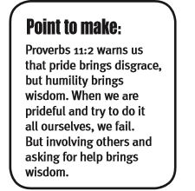
Delegation
Delegation is a key to any great leader. Jethro taught Moses the importance of building a strong team and delegating tasks to them.

Slide 12
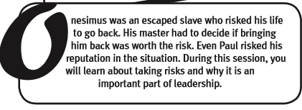
ONesimus

Slide 13
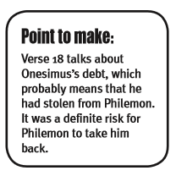
In the book of Philemon, Paul writes about Onesimus, a former slave who took a risk to escape slavery, but now takes a bigger risk to ask for forgiveness. Read Philemon vv.10-14 to get insight on the risks that Philemon, Onesimus, and Paul would take.

Slide 16
The Providence of God
(vv.15-16) Paul suggests that in God’s providence Onesimus abandoned Philemon during this short time for the purpose of Onesimus coming to faith in Christ Jesus. Theologians often describe this as God’s invisible hand moving about in the lives of those who are His often in order to bring good out of evil (Genesis 50:20; Romans 8: 28). As a result, the fellowship between Philemon and Onesimus would be rich, considering they were now brothers and free in Christ, slaves only to righteousness.

Slide 20
Are you willing to take the risk?

