Slide 1
JESUS IS WORTH FOLLOWING
Acts 3:1-4:24

Slide 2
What do you see?

Slide 3
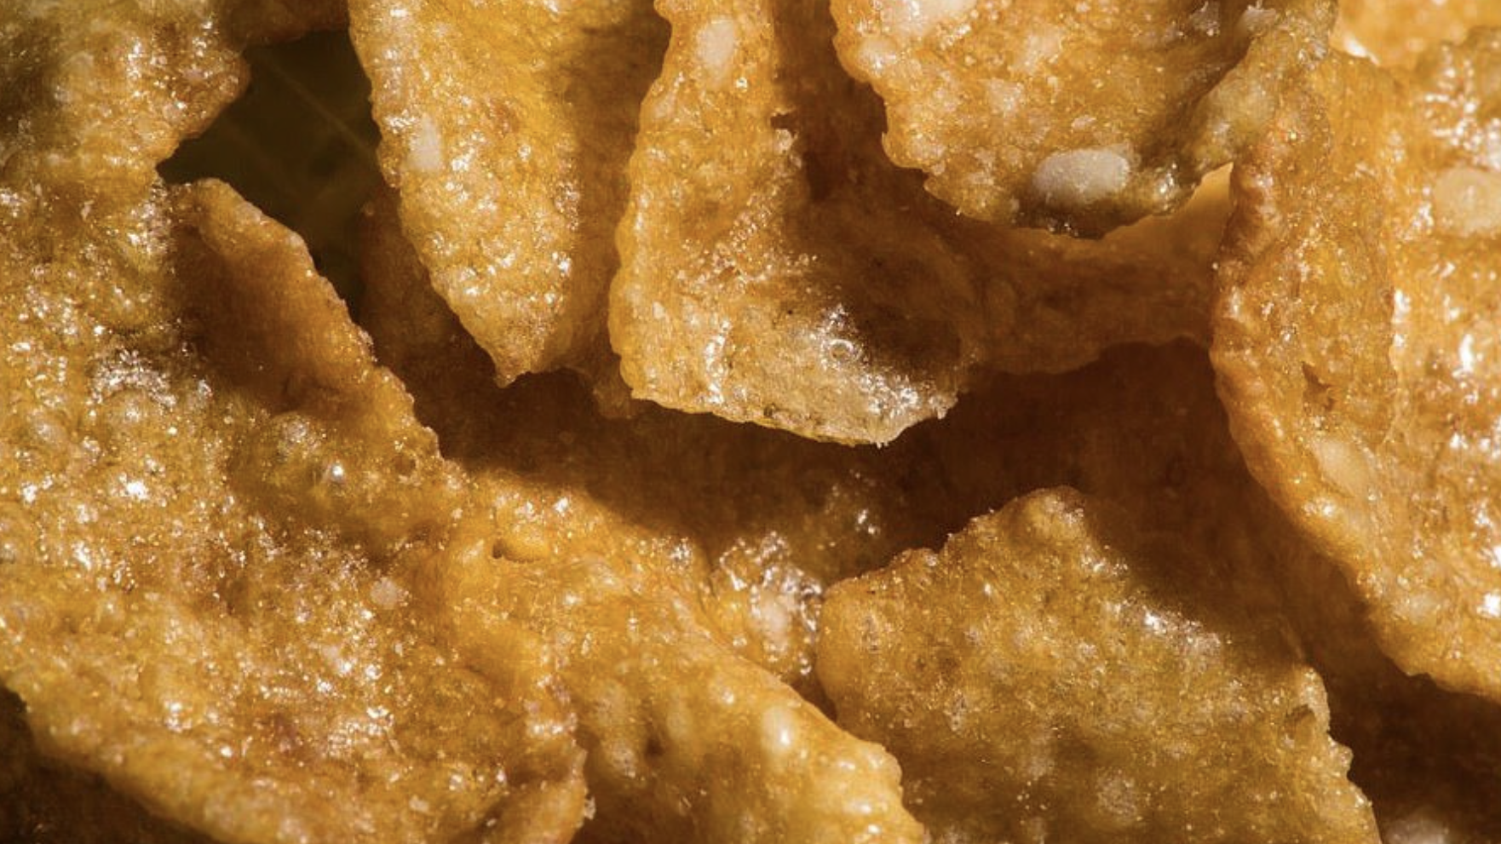

Slide 4
Cereal

Slide 6
Pages of a book

Slide 8
PAsta

Slide 10
match

Slide 12
Guitar

Slide 14
Stem of apple

Slide 16
Cap- Coca Cola Bottle

Slide 20
toothbrush

Slide 22
What is a Biblical Worldview?
Seeing the world through the lense (eyes) of Scripture.

Slide 23
5 Questions we need to ask ourselves

Slide 24
Origin – where did I come from? Created in the image of God.

Slide 26
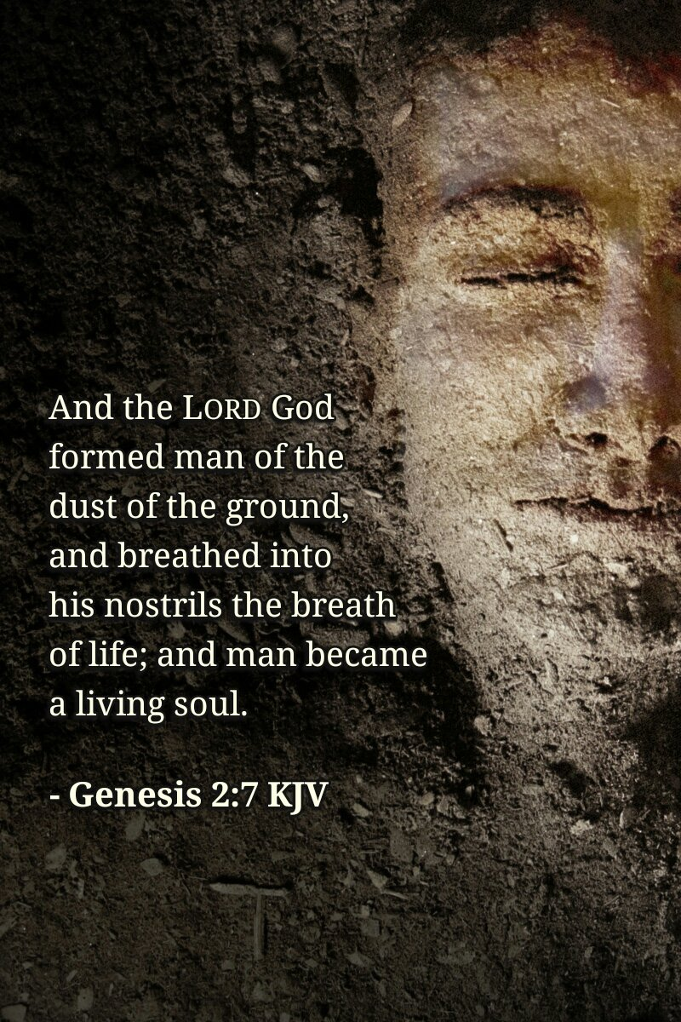

Slide 27
2. Destiny – where am I going? If you have received, Christ you will be with Him forever.

Slide 31
3. Purpose – Why am I here? Man’s purpose is to glorify God and enjoy Him forever.

Slide 32
Psalm 86:9

Slide 34
4. Values – how should I live? In a manner that glorifies God.

Slide 37
5. Truth – what is the truth? Truth is the self-expression of God.

Slide 40
SESSION 4: JESUS IS WORTH FOLLOWING BIBLE PASSAGE: Peter spoke Boldly about Jesus (Acts 3:1-4:24)

Slide 41
Peter spoke boldly about Jesus because He is worth following, even when times get tough. Peter was willing to put his life on the line to make Jesus known. He even ended up in prison for his faith.

Slide 42
1. God is praised when we serve Him faithfully in proclaiming His Gospel (Acts 3:1-10)

Slide 43
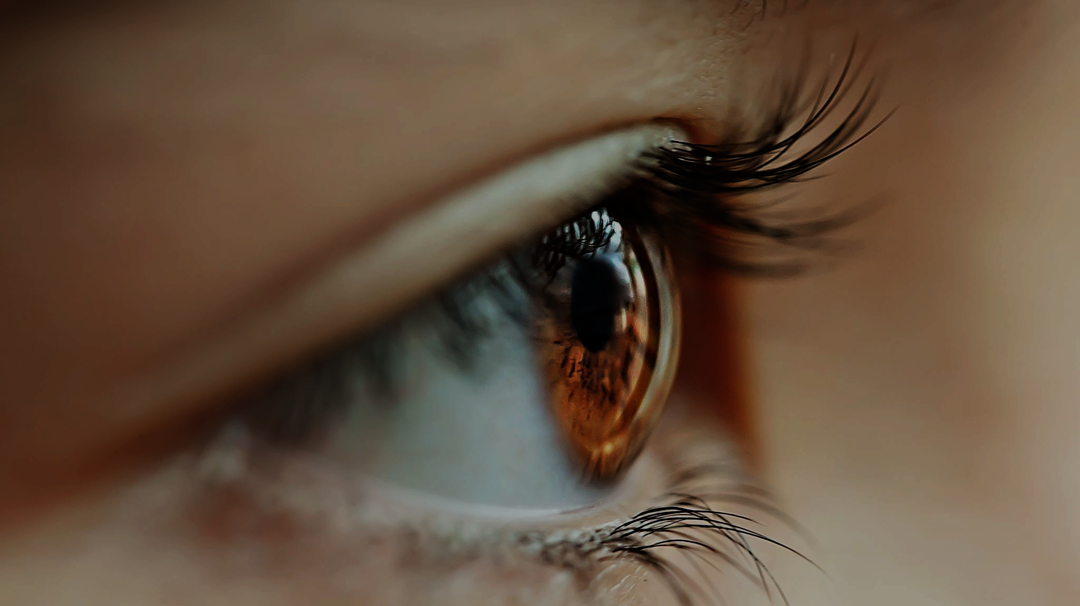
-They respond to the lame man’s plea for help -They value salvation more than material gain. -The man responds to be being healed by praising God. The name of God was feared.

Slide 44
2. God is praised when we preach the Gospel with boldness (Acts 3:11-26)

Slide 45
Peter and John did not take credit for the miracle.
They resisted the flattery of the people.
They transitioned into telling the people that their sins was the reason they needed a Savior.
Their message included the truth that the people needed to repent (change of heart and mind) and believe (trust) because they had killed Jesus.
Purpose- V. 26- save you from your evil ways.

Slide 46
3. God is praised when his children suffer for the cause of Christ (Acts 4:1-12)

Slide 47
4:3- They seized them and put them in Jail overnight
4:2- tells us that they did this because of the Gospel (message about Jesus’ resurrection, cf. verse 10)
4:5- When they had to give an answer before the court- Peter boldly proclaims the Gospel- changes nothing.
V. 12- Key verse- No salvation in anyone else- salvation is only in Christ Jesus.

Slide 48
3. God shows his power through faithful servants (Acts 4:13-22)

Slide 49
4:13- Observed their boldness, untrained men/uneducated
Recognized that God had used them to heal the lame man
v. 21- found no way to punish them because people were praising God.

Slide 50
5. God uses our witness to encourage others to serve with boldness (Acts 4:23, 31)

